Slide 1
HTML Frames

Slide 2
HTML FRAMES
HTML frames are used to divide your browser window into multiple sections, where each section can load a separate HTML document.
A collection of frames in the browser window is known as a frameset. The window is divided into frames in a similar way the tables are organized into rows and columns.

Slide 3
Creating Frames
To use frames on a page we use <frameset> tag instead of <body> tag.
The <frameset> tag defines, how to divide the window into frames.
The rows attribute of <frameset> tag defines horizontal frames
The cols attribute of <frameset> tag defines vertical frames.
Each frame is indicated by <frame> tag and it defines which HTML document shall open into the frame.
Note − The <frame> tag deprecated in HTML5.

Slide 4
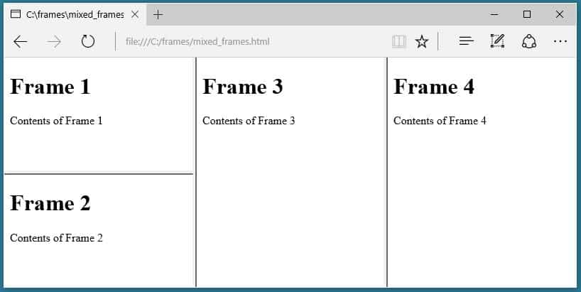
Diagrammatical representation

Slide 5
The <frameset> Tag Attributes
Cols
Specifies how many columns are contained in the frameset and the size of each column. You can specify the width of each column in one of the four ways −
Absolute values in pixels. For example, to create three vertical frames, use cols = "100, 500, 100".
A percentage of the browser window. For example, to create three vertical frames, use cols = "10%, 80%, 10%".
Using a wildcard symbol. For example, to create three vertical frames, use cols = "10%, *, 10%". In this case wildcard takes remainder of the window.

Slide 6
The <frameset> Tag Attributes
rows
This attribute works just like the cols attribute and takes the same values, but it is used to specify the rows in the frameset.
For example, to create two horizontal frames, use rows = "10%, 90%". You can specify the height of each row in the same way as explained above for columns.
border
This attribute specifies the width of the border of each frame in pixels. For example, border = "5". A value of zero means no border.

Slide 7
The <frameset> Tag Attributes
frameborder
This attribute specifies whether a three-dimensional border should be displayed between frames. This attribute takes value either 1 (yes) or 0 (no). For example frameborder = "0" specifies no border.

Slide 8
The <frame> Tag Attributes
src
This attribute is used to give the file name that should be loaded in the frame. Its value can be any URL. For example, src = "/html/top_frame.htm" will load an HTML file available in html directory.
name
This attribute allows you to give a name to a frame. It is used to indicate which frame a document should be loaded into. This is especially important when you want to create links in one frame that load pages into an another frame, in which case the second frame needs a name to identify itself as the target of the link.

Slide 9
The <frame> Tag Attributes
frameborder
This attribute specifies whether or not the borders of that frame are shown; it overrides the value given in the frameborder attribute on the <frameset> tag if one is given, and this can take values either 1 (yes) or 0 (no).
marginwidth
This attribute allows you to specify the width of the space between the left and right of the frame's borders and the frame's content. The value is given in pixels. For example marginwidth = "10".

Slide 10
The <frame> Tag Attributes
marginheight
This attribute allows you to specify the height of the space between the top and bottom of the frame's borders and its contents. The value is given in pixels. For example marginheight = "10".
noresize
By default, you can resize any frame by clicking and dragging on the borders of a frame. The noresize attribute prevents a user from being able to resize the frame. For example noresize = "noresize".

Slide 11
scrolling
This attribute controls the appearance of the scrollbars that appear on the frame. This takes values either "yes", "no" or "auto". For example scrolling = "no" means it should not have scroll bars.
longdesc
The longdesc attribute specifies a URL to a page that contains a long description of the content of a frame.
For example longdesc = "framedescription.htm"

Slide 12
Example
<!DOCTYPE html>
<html>
<frameset rows="10%,75%,10%" frameborder="0" >
<frame src="f1.html" frameborder="1">
<frame src="f2.html" frameborder="1">
<frame src="f3.html" frameborder="1">
</frameset>
</html>

Slide 13
Example
Using a wildcard symbol. For example, to create three vertical frames, use cols=“25%,*,25%”. In this case wildcard takes remainder of the window.
<!DOCTYPE html>
<html>
<frameset cols="25%,*,25%" border="10" bordercolor="red">
<frame src="f1.html" marginheight="355" marginwidth="255" > <!--scrolling="no"-->
<frame src="f2.html">
<frame src="f3.html">a
</frameset>
</html>

Slide 14
Nested frame sets
Framesets may be nested to any level.
In the following example, the outer FRAMESET divides the available space into three equal columns. The inner FRAMESET then divides the second area into two rows of unequal height.
<!DOCTYPE html>
<html>
<frameset cols="33%, 33%, 34%">
<frame src="a1.html">
<frameset rows="40%, 50%">
<frame src="a2.html">
<frame src="a2.html">
</frameset>
<frame src="a3.html">
</frameset>
</html>

Slide 15
HTML IFRAMES
An iframe is used to display a web page within a web page.
Inserting an iFrame on HTML Webpage.
The iframe Url address must be enclosed within the <iframe> element.
Syntax of an iframe.
<iframe src="Destination/iframe URL"> </iframe>
The src attribute specifies the URL (web address) of the inline frame page.
iFrame Attribute :width and height
height: Controls the height of the iframe. Values can be expressed in "px" or "%“
width: Controls the width of the iframe. Values can be expressed in "px" or "%".

Slide 16
iFrame attribute: frameborder
Frameborder: This attribute enables users to specify the border. Values are boolean in nature. Eg: 1 indicates border while "0" indicates "noborder"

Slide 17
Example:
<!DOCTYPE html>
<html>
<head>
<title>HTML Iframes</title>
</head>
<body>
<p>Document content goes here...</p>
<iframe src="f1.html" width="500" height="200" frameborder="1" marginheight="50px" marginwidth="10px" name="a">
Sorry your browser does not support inline frames.
</iframe> <br />
<iframe src="f2.html" width="250" height="200" frameborder="1">
Sorry your browser does not support inline frames.
</iframe>
<iframe src="f3.html" width="250" height="200" frameborder="1">
Sorry your browser does not support inline frames.
</iframe>
<p>Document content also go here...</p>
</body>
</html>

Slide 18
Iframe - Target for a Link
An iframe can be used as the target frame for a link.
The target attribute of the link must refer to the name attribute of the iframe:
<!DOCTYPE html>
<html>
<body>
<h2>Iframe - Target for a Link</h2>
<iframe height="500px" width="500px" src="ab.html" name="iframe_a"></iframe>
<p><a href="https://www.javatpoint.com/" target="iframe_a">Javatpoint</a></p>
<p>When the target of a link matches the name of an iframe, the link will open in the iframe.</p>
</body>
</html>

Slide 19
Advantages of using Frames
The advantages of HTML frames include:
The main advantage of frames is that it allows the user to view multiple documents within a single Web page.
It is possible to load pages from different servers in a single frameset.
The concern that older browsers do not support frames can be addressed using the <noframe> tag. This tag provides a section in an HTML document to include alternative content for browsers without support for frames. However, it requires that the Web designer provide two formats for one page.

Slide 20
Disadvantages of Frames
There are few drawbacks with using frames, so it's never recommended to use frames in your webpages −
One of the main disadvantage of frames is search engines will not deal with them properly. i.e, search engines (including most popular ones) will not index pages containing frames as its hard for them to search for a specific content and move backwards to check to which frameset each page belongs to and retrieve all the pages in the frameset.
We cannot bookmark individual pages using browser's favourite menu if they contain frames.
Some smaller devices cannot cope with frames often because their screen is not big enough to be divided up.
Sometimes your page will be displayed differently on different computers due to different screen resolution.
The browser's back button might not work as the user hopes.
There are still few browsers that do not support frame technology.

Slide 21
Reason for Google.com and some other sites not loading inside the frame
The reason for google.com not loading inside the frame is, that Google is sending an "X-Frame-Options: SAMEORIGIN" response header. This option prevents the browser from displaying iFrames that are not hosted on the same domain as the parent page.

Slide 22
Thank you

